Slide 1

Introduction to Computer Systems
CSCI3240: Lecture 1
Dr. Arpan Man Sainju
Middle Tennessee State University

Slide 2
Course Theme
Abstraction Is Good But Don’t Forget Reality
Abstractions have limits
Especially in the presence of bugs
Need to understand details of underlying implementations
Useful outcomes from taking CSCI3240
Become more effective programmers
Able to find and eliminate bugs efficiently
Able to understand and tune for program performance
Prepare for later “systems” classes in CS
Compilers, Operating Systems, Networks, etc.

Slide 3
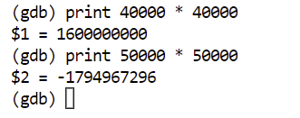
Great Reality #1: Ints are not Integers, Floats are not Reals
Example 1: Is x² ≥ 0?
Float’s:
Yes! (always true for Float)
Int’s:
40000 * 40000 → 1600000000
50000 * 50000 → ??
Example 2: Is (x + y) + z = x + (y + z)?
Unsigned & Signed Int’s: Yes!
Float’s:
(1e20 + -1e20) + 3.14 --> 3.14
1e20 + (-1e20 + 3.14) --> ??
???
Is addition Associative?

Slide 4
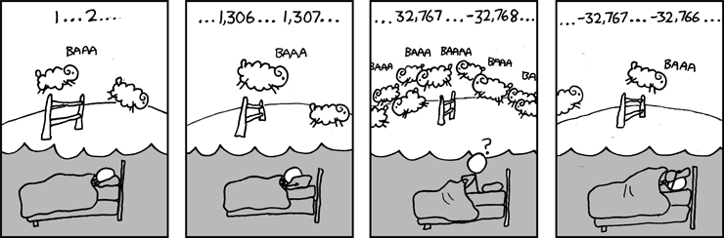
Great Reality #1: Ints are not Integers, Floats are not Reals

Slide 5
Computer Arithmetic
Does not generate random values
Arithmetic operations have important mathematical properties
Cannot assume all “usual” mathematical properties
Due to the finiteness of representations
Integer operations satisfy “ring” properties
Commutativity, associativity, distributivity
Floating point operations satisfy “ordering” properties
Monotonicity, values of signs

Slide 6
Great Reality #2: More Assembly
Chances are, you’ll never write programs in assembly
Compilers are much better & more patient than you are
But: Understanding assembly is key to the machine-level execution model
Behavior of programs in the presence of bugs
High-level language models break down
Tuning program performance
Understand optimizations done / not done by the compiler
Understanding sources of program inefficiency
Implementing system software
Compiler has machine code as the target
Operating systems must manage process state
Creating/fighting malware
x86 assembly is the language of choice!

Slide 7
Great Reality #3: Memory Matters Random Access Memory Is an Unphysical Abstraction
Memory is not unbounded
It must be allocated and managed
Many applications are memory dominated
Memory referencing bugs especially pernicious
Effects are distant in both time and space
Memory performance is not uniform
Cache and virtual memory effects can greatly affect program performance
Adapting program to characteristics of memory system can lead to major speed improvements

Slide 8
Memory Referencing Bug Example
typedef struct {
int a[2];
double d;
} struct_t;
double fun(int i) {
volatile struct_t s;
s.d = 3.14;
s.a[i] = 1073741824; /* Possibly out of bounds */
return s.d;
}
Console
fun(0) ➙ 3.14
fun(1) ➙ 3.14
fun(2) ➙ 3.1399998664856
fun(3) ➙ 2.00000061035156
fun(4) ➙ 3.14
fun(6) ➙ Segmentation fault

Slide 9
Memory Referencing Bug Example
typedef struct {
int a[2];
double d;
} struct_t;
fun(0) ➙ 3.14
fun(1) ➙ 3.14
fun(2) ➙ 3.1399998664856
fun(3) ➙ 2.00000061035156
fun(4) ➙ 3.14
fun(6) ➙ Segmentation fault
Explanation:
C/C++ will not do bound check for you. It is your responsibility as a programmer.
Critical State | 6
? | 5
? | 4
d7 ... d4 | 3
d3 ... d0 | 2
a[1] | 1
a[0] | 0
Location accessed by fun(i)
struct_t

Slide 10
Memory Referencing Errors
C and C++ do not provide any memory protection
Out-of-bounds array references
Invalid pointer values
Abuses of malloc/free
Can lead to nasty bugs
Whether or not bug has any effect depends on system and compiler
Action at a distance
Corrupted object logically unrelated to one being accessed
Effect of bug may be first observed long after it is generated
How can I deal with this?
Program in Java, Ruby, Python, ML, …
Understand what possible interactions may occur
Use or develop tools to detect referencing errors (e.g. Valgrind)

Slide 11
Great Reality #4: There’s more to performance than asymptotic complexity
Constant factors matter too!
And even exact op count does not predict performance
Easily see 10:1 performance range depending on how code written
Must optimize at multiple levels: algorithm, data representations, procedures, and loops
Must understand system to optimize performance
How programs are compiled and executed
How to measure program performance and identify bottlenecks
How to improve performance without destroying code modularity and generality

Slide 12
Memory System Performance Example
void copyij(int src[2048][2048],
int dst[2048][2048])
{
int i,j;
for (i = 0; i < 2048; i++)
for (j = 0; j < 2048; j++)
dst[i][j] = src[i][j];
}
void copyji(int src[2048][2048],
int dst[2048][2048])
{
int i,j;
for (j = 0; j < 2048; j++)
for (i = 0; i < 2048; i++)
dst[i][j] = src[i][j];
}
4.3ms
81.8ms
2.0 GHz Intel Core i7 Haswell
Hierarchical memory organization
Performance depends on access patterns
Including how step through multi-dimensional array

Slide 13
The Performance Differs
copyij
copyji

Slide 14
Great Reality #5: Computers do more than execute programs
They need to get data in and out
I/O system critical to program reliability and performance
They communicate with each other over networks
Many system-level issues arise in presence of network
Concurrent operations by autonomous processes
Coping with unreliable media
Cross platform compatibility
Complex performance issues

Slide 15
Course Perspective
CSCI3130 Assembly and Computer Organization
Builder-Centric
We built a Relatively Simple Computer (RSC) in Logisim
CSCI3240 Introduction to Computer Systems
Programmer-Centric
Purpose is to show that by knowing more about the underlying system, one can be more effective as a programmer
Enable you to
Write programs that are more reliable and efficient
Incorporate features that require hooks into OS
E.g., concurrency, signal handlers

Slide 16
Textbooks
Randal E. Bryant and David R. O’Hallaron,
Computer Systems: A Programmer’s Perspective, Third Edition (CS:APP3e), Pearson, 2016
http://csapp.cs.cmu.edu
This book really matters for the course!
How to solve projects
Practice problems typical of exam problems
Brian Kernighan and Dennis Ritchie,
The C Programming Language, Second Edition, Prentice Hall, 1988
Still the best book about C, from the originators

Slide 17
Course Components
Lectures
Higher level concepts
Quizzes
7 Quizzes
At max, three attempts are allowed.
Your final score will be based on your last attempt.
Total weight: 30%
Projects
4 Individual projects
Total weight: 40%
Exams
2 midterm exams.
Test your understanding of concepts & mathematical principles
Total weight: 30%

Slide 18
Class Discord
https://discord.gg/tjQSEbVafu

Slide 19
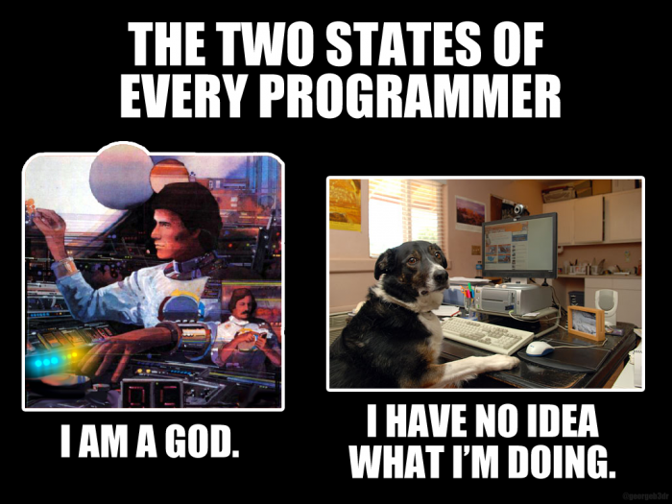
Enjoy the process

